Slide 1
Project Title: Air Quality Analysis Using Advanced MySQL Techniques and Excel Visualization
Student Name: AYESHA SINGH
Date: 02-MAY-2025

Slide 2
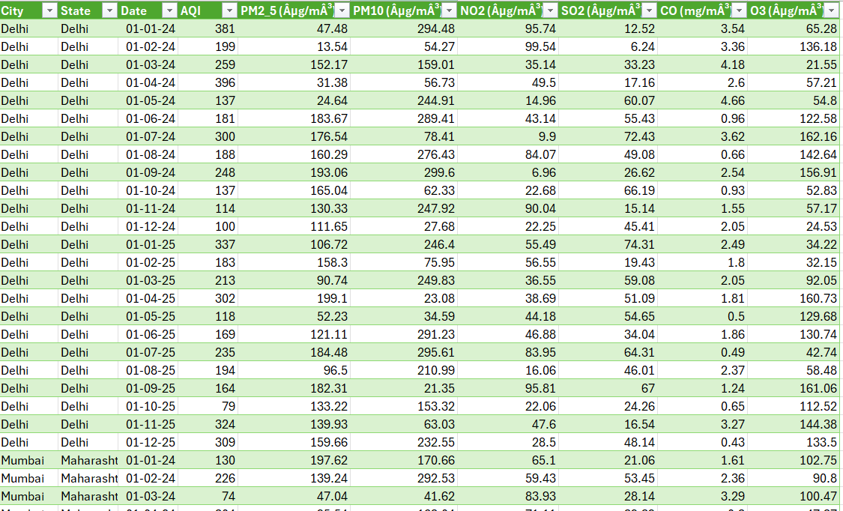

Air Quality Index Dataset
Main Objective:
To analyze and visualize air quality trends across different Indian cities using AQI (Air Quality Index) and pollutant data (PM2.5, PM10, NO2, SO2, CO, O3), and to generate insights for public health and environmental monitoring.

Slide 3
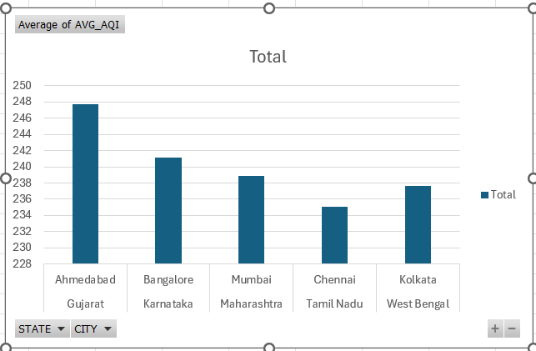
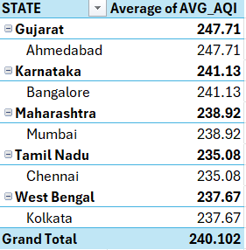
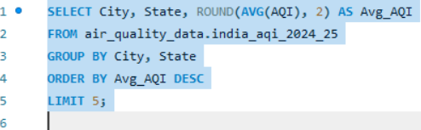
Task1:Average AQI by City and State
Ahmedabad (Gujarat) has the highest average AQI of 247.71, indicating poor air quality compared to other cities.
Bangalore (Karnataka) and Mumbai (Maharashtra) follow with average AQI levels of 241.13 and 238.92 respectively.
Chennai (Tamil Nadu) and Kolkata (West Bengal) have lower average AQI compared to other cities in the analysis.
The overall average AQI across all cities is 240.10, which is considered unhealthy.
Gujarat is the most polluted state in this group based on AQI, while Tamil Nadu has relatively cleaner air among the listed states.

Slide 4
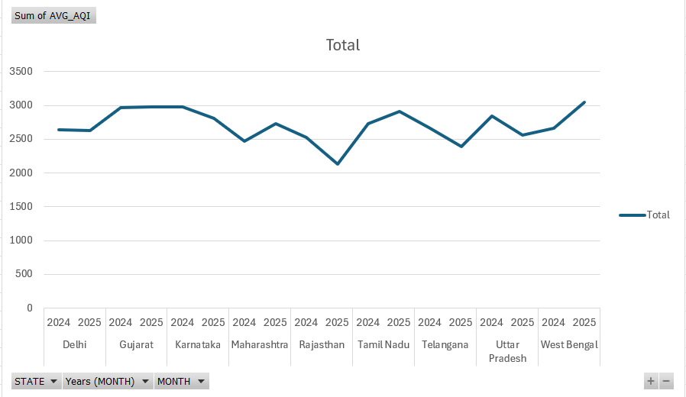
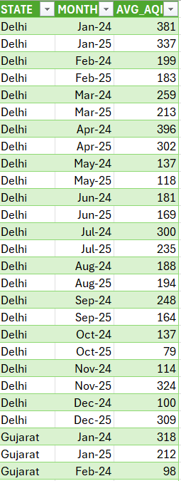
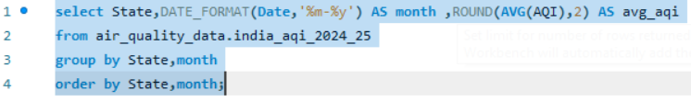
Task 2: Monthly AQI Trend in Delhi (2024–2025)
April 2024 had the highest AQI in Delhi (396), indicating very poor air quality in that month.
AQI dropped sharply in May and June 2024, reaching its lowest point in October 2025 (79).
A rise in AQI is observed again in November 2025 (324), showing seasonal air quality issues during late autumn/winter.
AQI levels fluctuate throughout the year, with higher pollution levels seen in January, April, and November.
Gujarat in Jan–Feb 2024 showed moderately high AQI (318 in Jan), but improved to 98 by Feb.

Slide 5
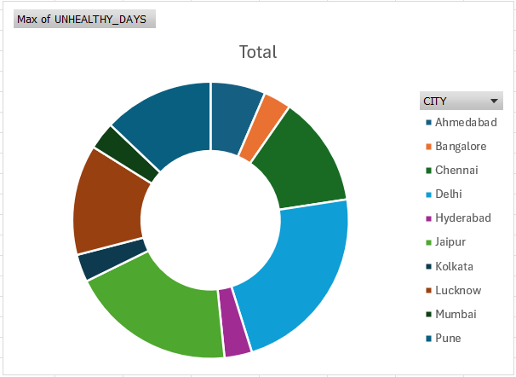
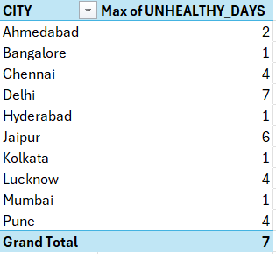
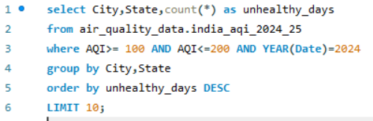
Task 3: Cities with Most 'Unhealthy' AQI Days in 2024
Delhi recorded the highest number of 'unhealthy' air quality days (7 days) in 2024.
Jaipur follows with 6 days, showing significant air pollution issues.
Chennai, Lucknow, and Pune each reported 4 unhealthy days, indicating moderate pollution levels.
Ahmedabad had 2 such days, while Bangalore, Hyderabad, Kolkata, and Mumbai each had 1 day in the unhealthy range.
Most affected cities are major urban centers, suggesting a link between urbanization and air pollution.
States like Delhi, Rajasthan, Tamil Nadu, Uttar Pradesh, and Maharashtra appear more frequently, highlighting regions that may need better pollution control measures.

Slide 6
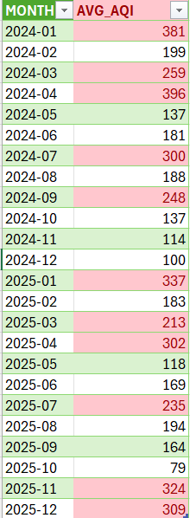
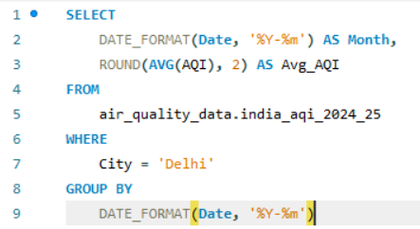
Task 4:Monthly Average AQI in Delhi (2024–2025)
Highest pollution levels were seen in:
April 2024 with an AQI of 396 – the worst month for air quality.
January 2024 (381) and January 2025 (337) also had very poor air quality.
Winter and early summer months (Jan–Apr) generally had higher AQI, indicating more pollution.
Air quality improved during late summer and monsoon months:
May 2024 (137), June 2024 (181), and August 2024 (188) showed better conditions.
The cleanest months were:
October 2025 (79) – the best air quality in two years.
November and December 2024 also had relatively low AQI values (114 and 100).
AQI spiked again in November 2025 (324) and December 2025 (309), likely due to seasonal factors like Diwali, crop burning, and winter smog.
Overall, Delhi’s air quality showed a seasonal pattern, with worse air in winter and better air in mid-year.

Slide 7
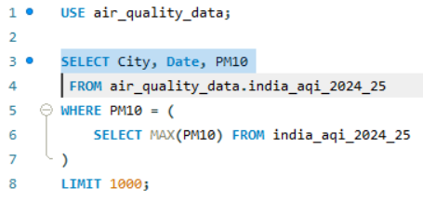

Task 5:Maximum PM10 Level in India (2024–2025)
The highest recorded PM10 level was 299.6 µg/m³.
This extreme value was observed in Delhi on September 1, 2024.
A PM10 level of 299.6 is considered "Very Poor" or close to "Severe" according to air quality standards.
This indicates serious air pollution in Delhi on that day, which could pose major health risks, especially to sensitive groups (children, elderly, and those with lung or heart conditions).
The high value in September might be due to post-monsoon dust, construction activities, or vehicular pollution.
Preventive actions and awareness are needed during such high-pollution days to protect public health
Out put:

Slide 8

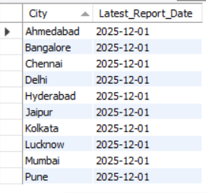
Task 6: Latest Air Quality Report Date (By City)
The most recent air quality data for all major cities is from December 1, 2025.
This includes cities like Delhi, Mumbai, Bangalore, Kolkata, Chennai, Hyderabad, Ahmedabad, Pune, Jaipur, and Lucknow.
It indicates that the dataset is updated till the end of 2025, providing a complete two-year range (2024–2025) for analysis.
This helps ensure the insights and trends derived are based on the latest available data.
Consistent report dates across cities improve the reliability and comparability of air quality analysis across different regions.
Out put:

Slide 9
Conclusion:
Key Outcomes:
Delhi showed the worst air quality, with the highest number of "Unhealthy" AQI days and maximum PM10 level.
April 2024 and January 2024/2025 had the highest average AQI, showing seasonal pollution spikes.
Air quality improves during monsoon months (May–August), but worsens again during winter.
All major cities have air quality data available till December 2025, ensuring complete and recent analysis.
Many cities like Chennai, Lucknow, and Pune also had several unhealthy air days, showing it's a nationwide issue.
Recommendations:
Increase green zones in urban areas to absorb pollutants.
Promote public transport and reduce the number of private vehicles on roads.
Control construction dust and improve waste management.
Raise awareness about pollution during peak months (winter and post-monsoon).
Government and public must work together to reduce emissions and keep the air clean.

Slide 10
THANK YOU

